Slide 1

Inventory Management and Sales Analytics for E-Commerce
TEAM MEMBERS :
NAME | NUID | NU EMAIL
Dharana Kashyap | 002055360 | kashyap.dh@northeastern.edu
Vidhi Patel | 002389224 | patel.vidhide@northeastern.edu
Udit Chaturvedi | 002246428 | chaturvedi.ud@northeastern.edu
Siddhanth Pai | 002054575 | pai.sid@northeastern.edu

Slide 2

Problem Statement
In growing e-commerce environments, managing inventory and processing customer orders manually often leads to costly mistakes — from stockouts and over-purchasing to missed discounts and inconsistent customer experiences. There was also no streamlined way to track returns or make sense of sales performance across roles.
Our goal was to automate these workflows end-to-end using a role-specific, trigger-driven, constraint-enforced database system that keeps everything consistent, secure, and insightful.

Slide 3

Aim
To build a comprehensive database-driven automation system for streamlining operations, improving accuracy, and enabling intelligent business decisions
We focused on four key outcomes: 1.Build role-based workflows for Admins, Sales Managers, Inventory Managers, and Analysts. 2.Enforce business rules and data integrity with PL/SQL triggers and procedures. 3.Enable complete automation of processes like onboarding, ordering, restocking, and returns. 4.Create meaningful analytics views to help with reporting and decision-making.

Slide 4
System Roles
The system is built around four main roles: Admin: Admin oversees user creation, constraints, and access permissions. Sales Manager: Sales Manager handles customer orders, payments, and returns. Inventory Manager: Inventory Manager ensures stock levels are healthy, restocks as needed, and manages suppliers. Analyst: Analyst uses views and reports to understand customer behavior, sales trends, and inventory flow.

Slide 5
Key Process
Here’s how some of the key processes were automated: Customer onboarding validates emails, ensures DOB and gender formatting, and inserts default addresses automatically. Order placement calculates total amount, checks for applicable discounts, verifies stock availability, and logs payments — all through a procedure. Inventory updates are handled via triggers: if a product is returned, stock levels are restored. If stock drops below threshold, an alert is logged.Returns processing is strict — quantity checks are enforced and over-returns are blocked. Discounts are immutable — they can’t be changed or deleted once created.

Slide 6
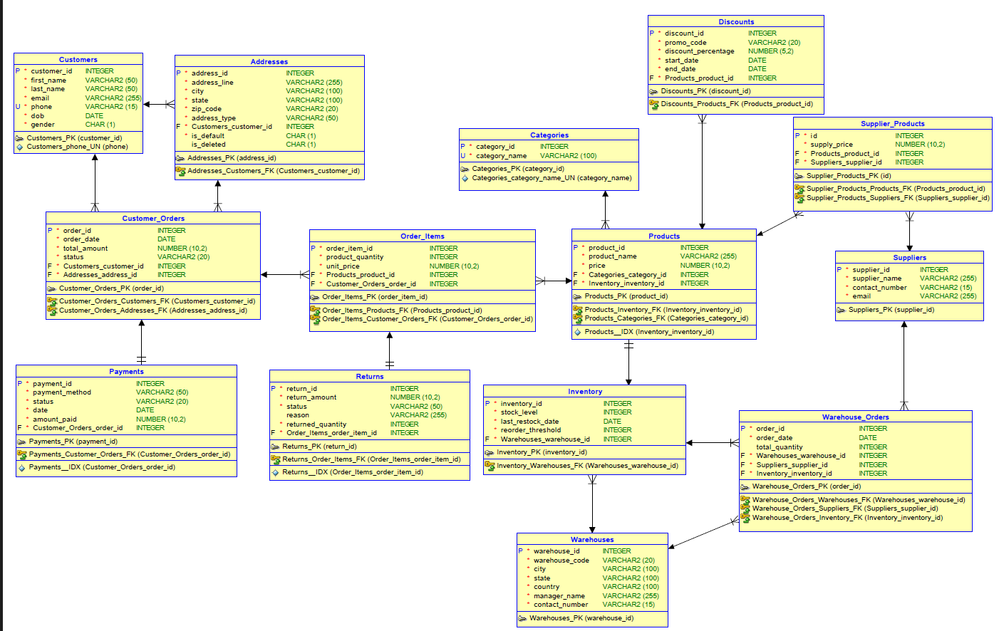
ER Diagram

Slide 7
Contributions
Dharana
1. Logical View for DB
2. Relational View for DB
3. Normalization Steps taken by team
4. Grants, Roles and User creation
5. Inventory Threshold and Immutable Discounts Trigger
6. Sales Payment Summary View
7. Discount Effectiveness View
8. Customer Behavior View
9. User Onboarding procedure
10. Validations and Exception Handling
11. Test cases
Udit
1. Customer Onboarding DFD
2. Order Management DFD
3. Order Return DFD
4. Warehouse Inventory Management DFD
5. User Onboarding procedure
Siddhanth
1. Current Inventory Status View
2. Total Sales Region Wise View
3. Top Selling Products View
4. Discount Effectiveness View
5. Supplier Lead Times View
6. Customer Purchase Frequency View
7. Customer Behavior View
8. Prevent Negative Stock Trigger
9. Place Restock Order Procedure
10. Receive Shipment Procedure
11. Test Cases
Vidhi
1. Business Outcomes Report
2. Triggers
3. Constraints
4. Sample Data
5. Validations and Exception Handling
6. Place Customer Order Procedure
7. Handle Return Procedure
8. Test cases

Slide 8
Github Link
https://github.com/dharanakneu/Inventory-Sales-Analytics-for-E-commerce.git
Thank you

